Slide 1
UNIVERSITY INSTITUTE OF ENGINEERING
COMPUTER SCIENCE ENGINEERING
Master of Engineering
ADVANCED DATA STRUCTURES
&
ALGORITHMS
(23CSH-622)
By : Dr. Ranjit Singh (E10947)
INTRODUCTION
DISCOVER . LEARN . EMPOWER

Slide 2
Contents of the Syllabus
UNIT-I (15h)
Introduction to Basic Data Structures: Importance and need of good data structures and algorithms, Introduction to linear and non-linear data structure and its importance, Algorithms Complexity and Analysis. [3]
Linear and Non –Linear Data Structures : Arrays , Link Lists, Queues , Trees and related algorithms [6]
Advanced Data Structures: AVL Trees (Insertion , Deletion , Searching), Red-Black Trees, B-trees, B+trees, Heaps. Data structure for disjoint sets, Augmented data structures. [6]
UNIT-II (15h)
Searching and Sorting : Internal and External Sorting algorithms: Linear Search, Binary Search, Bubble Sort, Selection Sort, Insertion Sort, Shell Sort, Quick Sort, Heap Sort, Merge Sort, Counting Sort, Radix Sort and analysis of their complexities and Hashing [4]
Graphs & Algorithms: Representation, Type of Graphs, Depth- and breadth-first traversals, Planar graphs, isomorphism, graph coloring, covering and partition, Minimum Spanning Tree: Prim’s and Kruskal’s algorithms. [6]
String Matching Algorithms: Naïve String Matching, Suffix arrays, Suffix trees, Rabin-Karp, Knuth-Morris-Pratt, Booyer-Moore algorithm [5]

Slide 3
Contents of the Syllabus
UNIT-III (15h)
Approximation algorithms: Need of approximation algorithms: Introduction to P, NP, NP-Hard and NP-Complete Greedy Approach, Dynamic Approach, Knapsack, Huffman Coding, TSP, All pair shortest path, Longest Common Subsequence Problem, Matrix Chain Multiplication. [7]
Randomized algorithms: Introduction, type of randomized algorithms, Quick sort, min cut [4]
Online Algorithms: Introduction, Online Paging Problem, k-server Problem. Data compression: Huffman’s coding, BWT, LZW. [4]
Recommended Books:
1. Cormen, Leiserson, Rivest, Stein, “Introduction to Algorithms”, Prentice Hall of India, 3rd edition 2012.
2. Horowitz, Sahni and Rajasekaran, “Fundamental of Computer, Algorithms”, University Press (India), 2nd edition.
3. Aho, Haperoft and Ullman, “The Design and analysis of Computer Algorithms”, Pearson Education India.

Slide 4
NP-Completeness
So far we’ve seen a lot of good news!
Such-and-such a problem can be solved quickly (i.e., in close to linear time, or at least a time that is some small polynomial function of the input size)
NP-completeness is a form of bad news!
Evidence that many important problems can not be solved quickly.
NP-complete problems really come up all the time!

Slide 5
NPC Problems
Vertex Cover(k): Given a graph G=(V, E) and an integer k, does G have a vertex cover with ≤k vertices?
Definition:
A vertex cover of G=(V, E) is V’⊆V such that every edge in E is incident to some v∈V’.

Slide 6
Traveling salesperson problem
NPC Problems
Given: A set of n planar points
Find: A closed tour which includes all points exactly once such that its total length is minimized.
This problem is NP-complete.

Slide 7
Why should we care?
Knowing that they are hard lets you stop beating your head against a wall trying to solve them…
Use a heuristic: come up with a method for solving a reasonable fraction of the common cases.
Solve approximately: come up with a solution that you can prove that is close to right.
Use an exponential time solution: if you really have to solve the problem exactly and stop worrying about finding a better solution.

Slide 8
Optimization & Decision Problems
Decision problems
Given an input and a question regarding a problem, determine if the answer is yes or no
Optimization problems
Find a solution with the “best” value
Optimization problems can be cast as decision problems that are easier to study
E.g.: the traveling salesperson problem
Optimization version:
Find the shortest tour
Decision version:
Is there a tour whose total length is less than or equal to a constant C ?

Slide 9
Algorithmic vs Problem Complexity
The algorithmic complexity of a computation is some measure of how difficult is to perform the computation (i.e., specific to an algorithm)
The complexity of a computational problem or task is the complexity of the algorithm with the lowest order of growth of complexity for solving that problem or performing that task.
e.g. the problem of searching an ordered list has at most logn time complexity.
Computational Complexity: deals with classifying problems by how hard they are.

Slide 10
Class of “P” Problems
Class P consists of (decision) problems that are solvable in polynomial time
Polynomial-time algorithms
Worst-case running time is O(n^{k}), for some constant k
Examples of polynomial time:
O(n²), O(n³), O(1), O(n lg n)
Examples of non-polynomial time:
O(2^{n}), O(n^{n}), O(n!)

Slide 11
Complexity Class P
Deterministic in nature
Solved by conventional computers in polynomial time
O(1) Constant
O(log n) Sub-linear
O(n) Linear
O(n log n) Nearly Linear
O(n²) Quadratic
Polynomial upper and lower bounds

Slide 12
Tractable/Intractable Problems
Problems in P are also called tractable
Problems not in P are intractable or unsolvable
Can be solved in reasonable time only for small inputs
Or, can not be solved at all
Are non-polynomial algorithms always worst than polynomial algorithms?
- n^{1,000,000} is technically tractable, but really impossible
- n^{log log log n} is technically intractable, but easy

Slide 13
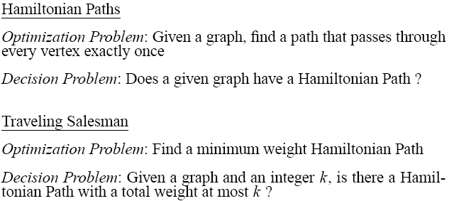
Examples of Intractable Problems

Slide 14
Intractable Problems
Can be classified in various categories based on their degree of difficulty, e.g.,
NP
NP-complete
NP-hard
Let’s define NP algorithms and NP problems …

Slide 15
Nondeterministic and NP Algorithms
Nondeterministic algorithm = two stage procedure:
Nondeterministic (“guessing”) stage:
generate randomly an arbitrary string that can be thought of as a candidate solution (“certificate”)
Deterministic (“verification”) stage:
take the certificate and the instance to the problem and returns YES if the certificate represents a solution
Furthermore, it is assumed that a nondeterministic algorithm always makes a correct guessing.
NP algorithms (Nondeterministic polynomial)
verification stage is polynomial

Slide 16
Nondeterministic algorithms
Non-deterministic part as well
choose(b): choose a bit in a non-deterministic way and assign to b
If someone tells us the solution to a problem, we can verify it in polynomial time
Two Properties: non-deterministic method to generate possible solutions, deterministic method to verify in polynomial time that the solution is correct.

Slide 17
Class of “NP” Problems
Class NP consists of problems that could be solved by NP algorithms
i.e., verifiable in polynomial time
If we were given a “certificate” of a solution, we could verify that the certificate is correct in time polynomial to the size of the input
Warning: NP does not mean “non-polynomial”

Slide 18
NP problem
If a decision problem can be solved by a NP algorithm, this problem is called an NP (nondeterministic polynomial) problem.
NP problems : (must be decision problems)

Slide 19
E.g.: Hamiltonian Cycle
Given: a directed graph G = (V, E), determine a simple cycle that contains each vertex in V
Each vertex can only be visited once
Certificate:
Sequence: ⟨v₁, v₂, v₃, …, v_{|V|}⟩
hamiltonian
not
hamiltonian

Slide 20
Is P = NP?
P
Any problem in P is also in NP:
P ⊆ NP
The big (and open question) is whether NP ⊆ P or P = NP
i.e., if it is always easy to check a solution, should it also be easy to find a solution?
Most computer scientists believe that this is false but we do not have a proof …
NP

Slide 21
NP-Completeness (informally)
NP-complete problems are
defined as the hardest
problems in NP
Most practical problems turn out to be either P or NP-complete.
Study NP-complete problems …
P
NP-complete
NP

Slide 22
Reductions
Reduction is a way of saying that one problem is “easier” than another.
We say that problem A is easier than problem B,
(i.e., we write “A ≤ B”)
if we can solve A using the algorithm that solves B.
Idea: transform the inputs of A to inputs of B
yes
α
f
β
Problem B
yes
no
no
Problem A

Slide 23
Polynomial Reductions
Given two problems A, B, we say that A is polynomially reducible to B (A ≤_{p} B) if:
There exists a function f that converts the input of A to inputs of B in polynomial time
A(i) = YES ⇔ B(f(i)) = YES

Slide 24
NP-Completeness (formally)
A problem B is NP-complete if:
(1) B ∈ NP
(2) A ≤_{p} B for all A ∈ NP
If B satisfies only property (2) we say that B is NP-hard
No polynomial time algorithm has been discovered for an NP-Complete problem
No one has ever proven that no polynomial time algorithm can exist for any NP-Complete problem
P
NP-complete
NP

Slide 25
Polynomial-Time Reducibility
Language L is polynomial-time reducible to language M if there is a function computable in polynomial time that takes an input x of L and transforms it to an input f(x) of M, such that x is a member of L if and only if f(x) is a member of M.
Shorthand, L^{poly} M means L is polynomial-time reducible to M
¦

Slide 26
NP-Hard and NP-Complete
Language M is NP-hard if every other language L in NP is polynomial-time reducible to M
For every L that is a member of NP, L^{poly} M
If language M is NP-hard and also in the class of NP itself, then M is NP-complete
¦

Slide 27
NPC and NP-hard
A problem A is NP-hard if every NP problem reduces to A.
A problem A is NP-complete (NPC) if A∈NP and every NP problem reduces to A.
Or we can say a problem A is NPC if A∈NP and A is NP-hard.

Slide 28
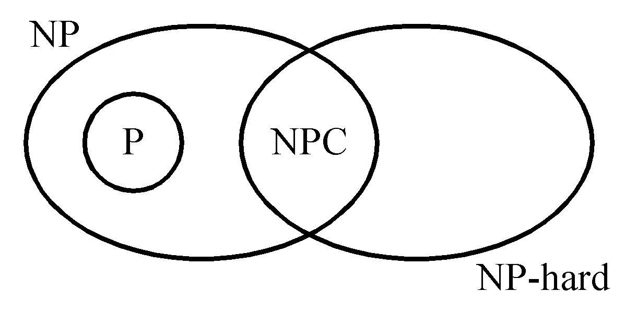
P: the class of problems which can be solved by a deterministic polynomial algorithm.
NP : the class of decision problem which can be solved by a non-deterministic polynomial algorithm.
NP-hard: the class of problems to which every NP problem reduces.
NP-complete (NPC): the class of problems which are NP-hard and belong to NP.

Slide 29
NP-Hard and NP-Complete
Restriction: A known NP-complete problem M is actually just a special case of L
Local replacement: reduce a known NP-complete problem M to L by dividing instances of M and L into “basic units” then showing each unit of M can be converted to a unit of L
Component design: reduce a known NP-complete problem M to L by building components for an instance of L that enforce important structural functions for instances of M.

Slide 30
Implications of Reduction
α
β
yes
yes
f
Problem B
no
no
Problem A
- If A ≤_{p} B and B ∈ P, then A ∈ P
- if A ≤_{p} B and A ∉ P, then B ∉ P

Slide 31
Proving Polynomial Time
Polynomial time algorithm to decide A
yes
α
f
β
Polynomial time
algorithm to decide B
yes
no
no
Use a polynomial time reduction algorithm to
transform A into B
Run a known polynomial time algorithm for B
Use the answer for B as the answer for A

Slide 32
Proving NP-Completeness
Theorem: If A is NP-Complete and A ≤_{p} B
⇒ B is NP-Hard
In addition, if B ∈ NP
⇒ B is NP-Complete
Proof: Assume that B ∈ P
Since A ≤_{p} B ⇒ A ∈ P contradiction!
⇒ B is NP-Hard

Slide 33
Proving NP-Completeness In Practice
Prove that the problem B is in NP
A randomly generated string can be checked in polynomial time to determine if it represents a solution
Show that one known NP-Complete problem can be transformed to B in polynomial time
No need to check that all NP-Complete problems are reducible to B

Slide 34
Revisit “Is P = NP?”
P
NP-complete
NP
Theorem: If any NP-Complete problem can be solved in polynomial time ⇒ then P = NP.

Slide 35
NP-Completeness
“NP-complete problems”: the hardest problems in NP
Interesting property
If any one NP-complete problem can be solved in polynomial time, then every problem in NP can also be solved similarly (i.e., P=NP)
Many believe P≠NP

Slide 36
Relationship Between NP and P
It is not known whether P=NP or whether P is a proper subset of NP
It is believed NP is much larger than P
But no problem in NP has been proved as not in P
No known deterministic algorithms that are polynomially bounded for many problems in NP
So, “does P = NP?” is still an open question!

Slide 37
P & NP-Complete Problems
Shortest simple path
Given a graph G = (V, E) find a shortest path from a source to all other vertices
Polynomial solution: O(VE)
Longest simple path
Given a graph G = (V, E) find a longest path from a source to all other vertices
NP-complete

Slide 38
P & NP-Complete Problems
Euler tour
G = (V, E) a connected, directed graph find a cycle that traverses each edge of G exactly once (may visit a vertex multiple times)
Polynomial solution O(E)
Hamiltonian cycle
G = (V, E) a connected, directed graph find a cycle that visits each vertex of G exactly once
NP-complete

Slide 39
Some NP-Complete Problems
Six basic genres of NP-complete problems and paradigmatic examples.
Packing problems: SET-PACKING, INDEPENDENT SET.
Covering problems: SET-COVER, VERTEX-COVER.
Constraint satisfaction problems: SAT, 3-SAT.
Sequencing problems: HAMILTONIAN-CYCLE, TSP.
Partitioning problems: 3D-MATCHING 3-COLOR.
Numerical problems: SUBSET-SUM, KNAPSACK.
Practice. Most NP problems are either known to be in P or NP-complete.
Notable exceptions. Factoring, graph isomorphism, Nash equilibrium.
Notes:
Nash equilibria in two-person non-zero-sum game always exist, but major open question to *find* such a solution in poly-time. [Is there a corresponding decision problem or is only the search problem interesting from a computational complexity viewpoint?]

Slide 40
Extent and Impact of NP-Completeness
Extent of NP-completeness
Prime intellectual export of CS to other disciplines.
6,000 citations per year (title, abstract, keywords).
more than "compiler", "operating system", "database"
Broad applicability and classification power.
"Captures vast domains of computational, scientific, mathematical endeavors, and seems to roughly delimit what mathematicians and scientists had been aspiring to compute feasibly."
NP-completeness can guide scientific inquiry.
1926: Ising introduces simple model for phase transitions.
1944: Onsager solves 2D case in tour de force.
19xx: Feynman and other top minds seek 3D solution.
2000: Istrail proves 3D problem NP-complete.
Notes:
Ernst Ising proposed simple model for phase transitions that is of fundamental importance in physics.
One of most exiting periods in statistical mechanics when Norwegian chemist Lars Onsager (and Nobel laureate) discovered solution to Ising model of ferromagnetism on 2D lattice.
Result energized many of the most brilliant physicist and mathematicians for solution to more realistic 3D model.
Spin glass Ising model from statistical mechanics (2d version unrealistic, 3d is the one everyone wanted to sovle)

Slide 41
More Hard Computational Problems
Aerospace engineering: optimal mesh partitioning for finite elements.
Biology: protein folding.
Chemical engineering: heat exchanger network synthesis.
Civil engineering: equilibrium of urban traffic flow.
Economics: computation of arbitrage in financial markets with friction.
Electrical engineering: VLSI layout.
Environmental engineering: optimal placement of contaminant sensors.
Financial engineering: find minimum risk portfolio of given return.
Game theory: find Nash equilibrium that maximizes social welfare.
Genomics: phylogeny reconstruction.
Mechanical engineering: structure of turbulence in sheared flows.
Medicine: reconstructing 3-D shape from biplane angiocardiogram.
Operations research: optimal resource allocation.
Physics: partition function of 3-D Ising model in statistical mechanics.
Politics: Shapley-Shubik voting power.
Pop culture: Minesweeper consistency.
Statistics: optimal experimental design.

Slide 42
PTAS
Polynomial-Time Approximation Schemes
Much faster, but not guaranteed to find the best solution
Come as close to the optimum value as possible in a reasonable amount of time
Take advantage of rescalability property of some hard problems

Slide 43
Algorithm Design Techniques
Backtracking Algorithm
Divide and Conquer Approach
Greedy Technique
Dynamic Programming

Slide 44
Backtracking
Effective for decision problems
Systematically traverse through possible paths to locate solutions or dead ends
At the end of the path, algorithm is left with (x, y) pair. x is remaining subproblem, y is set of choices made to get to x
Initially (x, Ø) passed to algorithm

Slide 45
Backtracking:
Backtracking is one of the techniques that can be used to solve the problem.
It uses the Brute force search to solve the problem, and the brute force search says that for the given problem, we try to make all the possible solutions and pick out the best solution from all the desired solutions.
Backtracking is used when we have multiple solutions, and we require all those solutions.
Backtracking name itself suggests that we are going back and coming forward; if it satisfies the condition, then return success, else we go back again.
It is used to solve a problem in which a sequence of objects is chosen from a specified set so that the sequence satisfies some criteria.

Slide 46
When to use a Backtracking algorithm?
When we have multiple choices, then we make the decisions from the available choices. In the following cases, we need to use the backtracking algorithm:
A piece of sufficient information is not available to make the best choice, so we use the backtracking strategy to try out all the possible solutions.
Each decision leads to a new set of choices. Then again, we backtrack to make new decisions. In this case, we need to use the backtracking strategy.

Slide 47
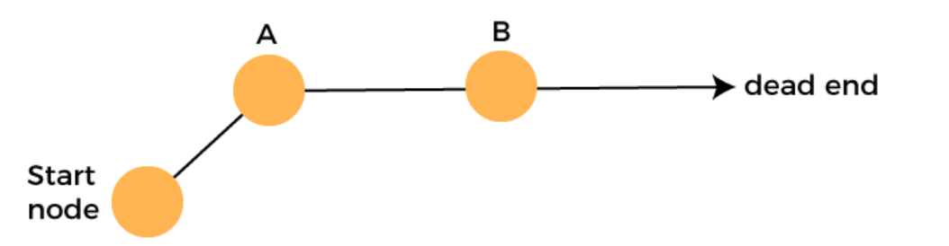
How does Backtracking work?
Backtracking is a systematic method of trying out various sequences of decisions until you find out that works. Let's understand through an example.
We start with a start node. First, we move to node A. Since it is not a feasible solution so we move to the next node, i.e., B. B is also not a feasible solution, and it is a dead-end so we backtrack from node B to node A.

Slide 48
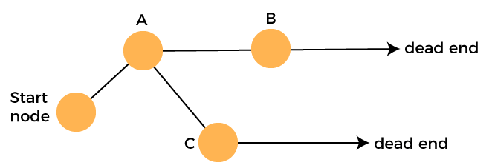
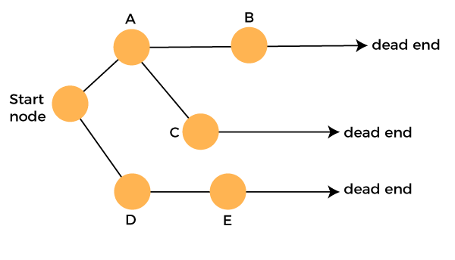
Suppose another path exists from node A to node C. So, we move from node A to node C. It is also a dead-end, so again backtrack from node C to node A. We move from node A to the starting node.
Now we will check any other path exists from the starting node. So, we move from start node to the node D. Since it is not a feasible solution so we move from node D to node E. The node E is also not a feasible solution. It is a dead end so we backtrack from node E to node D.

Slide 49
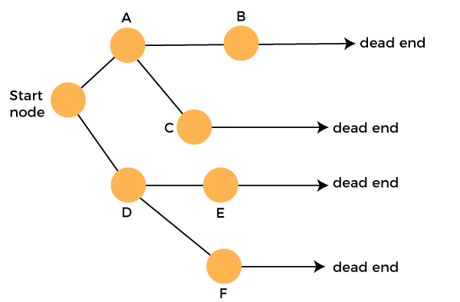
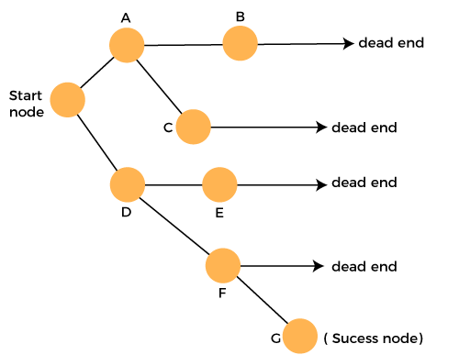
Suppose another path exists from node D to node F. So, we move from node D to node F. Since it is not a feasible solution and it's a dead-end, we check for another path from node F.
Suppose there is another path exists from the node F to node G so move from node F to node G. The node G is a success node.

Slide 50
The terms related to the backtracking are:
Live node: The nodes that can be further generated are known as live nodes.
Success node: The node is said to be a success node if it provides a feasible solution.
Dead node: The node which cannot be further generated and also does not provide a feasible solution is known as a dead node.

Slide 51
Recursive Backtracking:
Pseudo code for recursive backtracking algorithms
If at a solution, report success
for( every possible choice from current state / node)
Make that choice and take one step along path
Use recursion to solve the problem for the new node / state
If the recursive call succeeds, report the success to the next high level
Back out of the current choice to restore the state at the beginning of the loop.
Report failure

Slide 52
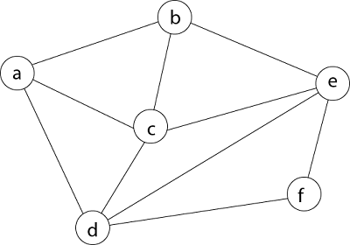
Problem :Hamiltonian Circuit Problem:
Consider a graph G = (V, E) shown in fig. we have to find a Hamiltonian circuit using Backtracking method.

Slide 53

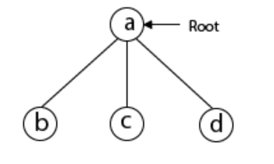
Solution:
Firstly, we start our search with vertex 'a.' this vertex 'a' becomes the root of our implicit tree.
Next, we choose vertex 'b' adjacent to 'a' as it comes first in lexicographical order (b, c, d).

Slide 54
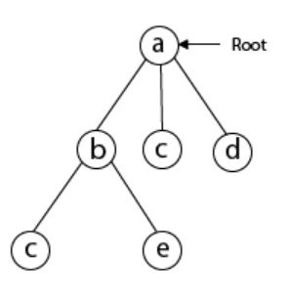
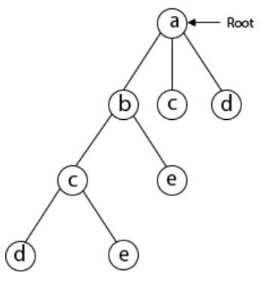
Next, we select 'c' adjacent to 'b.'
Next, we select 'd' adjacent to 'c.'

Slide 55
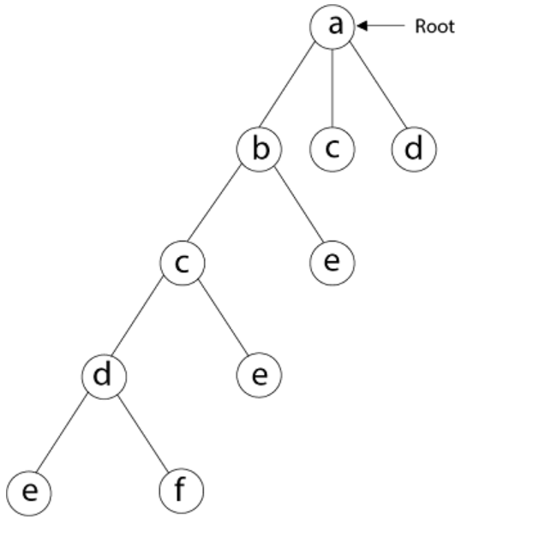
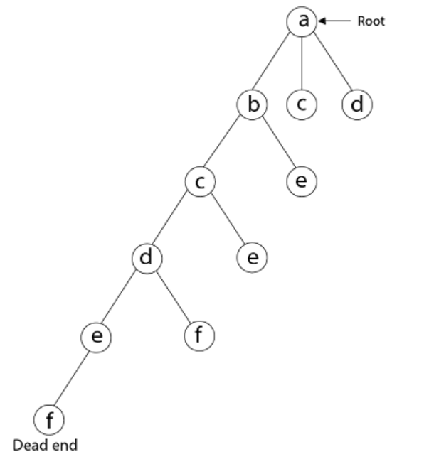
Next, we select 'e' adjacent to 'd.'
Next, we select vertex 'f' adjacent to 'e.' The vertex adjacent to 'f' is d and e, but they have already visited. Thus, we get the dead end, and we backtrack one step and remove the vertex 'f' from partial solution.

Slide 56
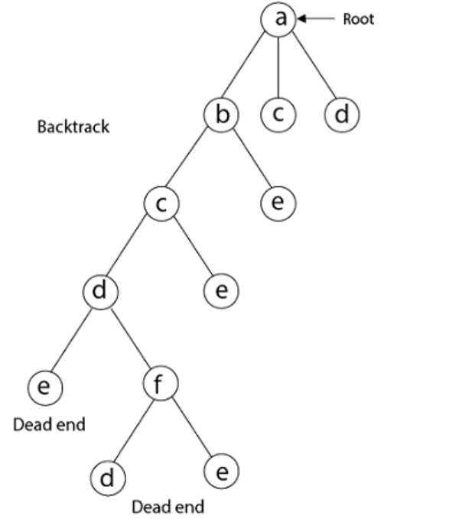
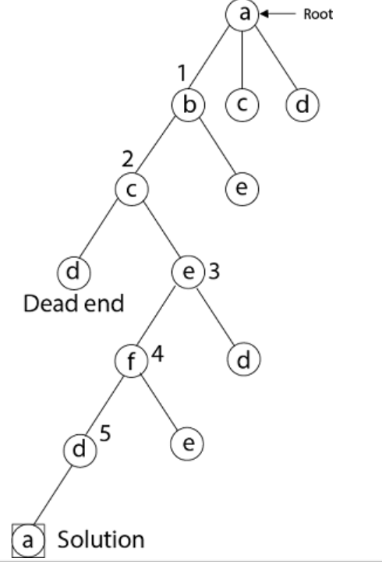
Backtrack
Again Backtrack

Slide 57
From backtracking, the vertex adjacent to 'e' is b, c, d, and f from which vertex 'f' has already been checked, and b, c, d have already visited. So, again we backtrack one step. Now, the vertex adjacent to d are e, f from which e has already been checked, and adjacent of 'f' are d and e. If 'e' vertex, revisited them we get a dead state. So again we backtrack one step.
Now, adjacent to c is 'e' and adjacent to 'e' is 'f' and adjacent to 'f' is 'd' and adjacent to 'd' is 'a.' Here, we get the Hamiltonian Cycle as all the vertex other than the start vertex 'a' is visited only once. (a - b - c - e - f -d - a).

Slide 58
Branch-and-Bound
Effective for optimization problems
Extended Backtracking Algorithm
Instead of stopping once a single solution is found, continue searching until the best solution is found
Has a scoring mechanism to choose most promising configuration in each iteration

Slide 59
Divide-and-Conquer
The most-well known algorithm design strategy:
Divide instance of problem into two or more smaller instances
Solve smaller instances recursively
Obtain solution to original (larger) instance by combining these solutions

Slide 60
Divide and Conquer (contd.)
Problem of size n
Subproblem 1 of size n/2
Subproblem 2 of size n/2
Don’t assume
always breaks up
into 2, could be > 2
subproblems
Solution to subproblem 1
Solution to subproblem 2
Solution to the original probelm

Slide 61
Time Complexity of the General Algorithm
Time Complexity
time of splitting
time of merging
constant

Slide 62
Find the maximum and minimum
The problem: Given a list of unordered n elements, find max and min
The straightforward algorithm:
max ← min ← A (1);
for i ← 2 to n do
if A (i) > max, max ← A (i);
if A (i) < min, min ← A (i);
Key comparisons: 2(n – 1)

Slide 63
List List 1 List 2
n elements n/2 elements n/2 elements
min, max min1, max1 min2, max2
min = MIN ( min1, min2 )
max = MAX ( max1, max2)

Slide 64
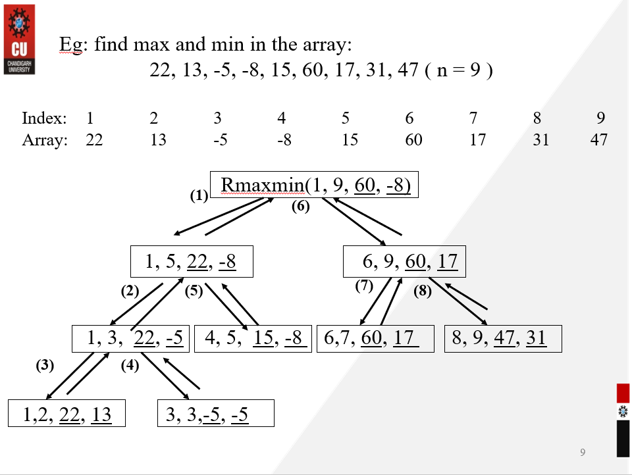

Slide 65
Analysis: For algorithm containing recursive calls, we can use recurrence relation to find its complexity
T(n) - # of comparisons needed for Rmaxmin Recurrence relation:
Assume n = 2^{k} for some integer k

Slide 66
When to use Divide & Conquer
Your problem has a structure that makes it easy to split up
Usually in half, but not always…
You can split “what you’re looking for” (subarrays, inversions, etc.) into “just in one of the parts” and “split across parts”
The “split” ones can be studied faster than brute force.

Slide 67
Divide-and-Conquer Examples
Binary search: decrease-by-half (or degenerate divide&conq.)
Sorting: Mergesort and Quicksort
Binary tree traversals
Multiplication of large integers
Matrix multiplication: Strassen’s algorithm

Slide 68

Greedy Approach
Optimization Problem: Problems with an objective function to either
Maximize some profit
Minimize the cost
Two techniques for solving optimization problem
Greedy Approach
Dynamic Programming
Greedy algorithm works in phases. At each phase:
You take the best you can get right now, without regard for future consequences
You hope that by choosing a local optimum at each step, you will end up at a global optimum

Slide 69
Example: Counting Money
Suppose you want to count out a certain amount of money, using the fewest possible currency notes and coins
A greedy algorithm to do this would be: At each step, take the largest possible bill or coin that does not overshoot
Example: There is Rs 5, 1, .25, .10 and .001 unlimited currency. How to make Rs 6.39 with minimum currency notes/coins
To make Rs 6.39, you can choose:
a Rs 5
a Rs1 bill, to make Rs 6
a 25p coin, to make Rs 6.25
a 10p coin, to make Rs 6.35
four 1p coins, to make Rs 6.39
Notes:
3

Slide 70
Greedy Algorithm Failure
In some (fictional) monetary system, “krons” come in 1 kron, 7 kron, and 10 kron coins
Using a greedy algorithm to count out 15 krons, you would get
A 10 kron piece
Five 1 kron pieces, for a total of 15 krons
This requires six coins
A better solution would be to use two 7 kron pieces and one 1 kron piece
This only requires three coins
The greedy algorithm results in a solution, but not in an optimal solution
Notes:
4

Slide 71
APPLICATIONS
Standard Greedy Algorithms :
Activity Selection Problem
Job Sequencing Problem
Huffman Coding
Greedy Algorithms in Graphs :
Kruskal’s Minimum Spanning Tree
Prim’s Minimum Spanning Tree
Dijkastra’s Shortest Path Algorithm
Greedy Algorithms in Operating Systems :
First Fit algorithm in Memory Management
Best Fit algorithm in Memory Management
Worst Fit algorithm in Memory Management
Shortest Job First Scheduling

Slide 72
Dynamic Programming
Dynamic Programming is mainly an optimization over plain recursion.
Wherever we see a recursive solution that has repeated calls for same inputs, we can optimize it using Dynamic Programming.
The idea is to simply store the results of subproblems, so that we do not have to re-compute them when needed later.
This simple optimization reduces time complexities from exponential to polynomial.

Slide 73
How does it works?
The following are the steps that the dynamic programming follows:
It breaks down the complex problem into simpler subproblems.
It finds the optimal solution to these sub-problems.
It stores the results of subproblems (memoization). The process of storing the results of subproblems is known as memorization.
It reuses them so that same sub-problem is calculated more than once.
Finally, calculate the result of the complex problem.

Slide 74
Solving a DP Problem.
Dynamic Programming solutions are faster than the exponential brute method and can be easily proved for their correctness.
Steps to solve a DP
1) Identify if it is a DP problem
2) Decide a state expression with least parameters
3) Formulate state relationship
4) Do tabulation (or add memoization)

Slide 75
Steps to solve
Step 1: How to classify a problem as a Dynamic Programming Problem?
Two characteristics that a problem has for a Dynamic Programming solution to work are :
Optimal Substructure
Overlapping Subproblems

Slide 76
Overlapping Subproblems: Dynamic Programming combines solutions to sub-problems. Dynamic Programming is mainly used when solutions of the same subproblems are needed again and again. In dynamic programming, computed solutions to subproblems are stored in a table so that these don’t have to be recomputed.
A given problems has Optimal Substructure Property if optimal solution of the given problem can be obtained by using optimal solutions of its subproblems.

Slide 77
Step 2 : Deciding the state
DP problems are all about state and their transition.
When a complex problem is divided into several subproblems, each subproblem forms a stage of the solution.
After calculating the solution for each stage and choosing the best ones we get to the final optimized solution.
Step 3: Formulating a relation among the states
At each stage, we need to choose the option which leads to the most desirable solution.
Choosing the most desirable option at every stage will eventually lead to an optimal solution in the end.

Slide 78
Dynamic Programming: Computing View
A
B
C
B
E
F
G
E
G
H
E
F
G
Notes:
note the extensive repetition of sub problems. We solve e and g several times. Even worse, we solve b twice. DP trades memory for time by saving intermediate results.

Slide 79
Dynamic Programming: Computing View
A
B
C
B
E
F
G
E
G
H
E
F
G
start solving sub-problems at the bottom.
Notes:
this is the bottom up approach to DP. It works well with the tables we’ll be drawing later. We solve sub problems first.

Slide 80
Dynamic Programming: Computing View
A
E solution_{E}
F solution_{F}
G solution_{G}
B
C
B
E
F
G
E
G
H
E
F
G
Build a table of results as you go
Notes:
strictly speaking, we should have solved all the leaves before proceeding upward.

Slide 81
Dynamic Programming
A
E solution_{E}
F solution_{F}
G solution_{G}
B solution_{B}
B
C
B
E
F
G
E
G
H
E
F
G
Avoid recomputing intermediate results

Slide 82
Dynamic Programming:
A
A
B
C
B
B
C
E
F
G
E
G
H
E
F
G
E
F
G
H
Notes:
the second tree shows the work that actually gets done using a memory function.

Slide 83
Properties of a problem that can be solved with dynamic programming
Simple Subproblems
We should be able to break the original problem to smaller subproblems that have the same structure
Optimal Substructure of the problems
The solution to the problem must be a composition of subproblem solutions
Subproblem Overlap
Optimal subproblems to unrelated problems can contain subproblems in common

Slide 84
Problem:
Let’s consider the calculation of Fibonacci numbers:
F(n) = F(n-2) + F(n-1)
with seed values F(1) = 1, F(2) = 1
or F(0) = 0, F(1) = 1
What would a series look like:
0, 1, 1, 2, 3, 4, 5, 8, 13, 21, 34, 55, 89, 144, …

Slide 85
Recursive Algorithm:
Fib(n)
{
if (n == 0)
return 0;
if (n == 1)
return 1;
Return Fib(n-1)+Fib(n-2)
}

Slide 86
Recursive Algorithm:
Fib(n)
{
if (n == 0)
return 0;
if (n == 1)
return 1;
Return Fib(n-1)+Fib(n-2)
}
It has a serious issue!

Slide 87
Recursion tree
What’s the problem?

Slide 88
Memoization:
Fib(n)
{
if (n == 0)
return M[0];
if (n == 1)
return M[1];
if (Fib(n-2) is not already calculated)
call Fib(n-2);
if(Fib(n-1) is already calculated)
call Fib(n-1);
//Store the ${n}^{th}$ Fibonacci no. in memory & use previous results.
M[n] = M[n-1] + M[n-2]
Return M[n];
}

Slide 89
Fibonacci Numbers
Fib(5) +
Fib(4) +
Fib(3) +
Fib(3) +
Fib(2) +
Fib(2) +
Fib(1)
Fib(2) +
Fib(1)
Fib(1)
Fib(0)
Fib(1)
Fib(0)
Fib(1)
Fib(0)

Slide 90
Dynamic programming
- Main approach: recursive, holds answers to a sub problem in a
table, can be used without recomputing.
Can be formulated both via recursion and saving results in a
table (memoization). Typically, we first formulate the recursive
solution and then turn it into recursion plus dynamic
programming via memoization or bottom-up.
-”programming” as in tabular not programming code

Slide 91
Applications-Real life scenarios
The various applications of Dynamic Programming are :
Longest Common Subsequence
Finding Shortest Path
Finding Maximum Profit with other Fixed Constraints
Job Scheduling in Processor
BioInformatics
Optimal search solutions

Slide 92
Questions
Q1. How does the dynamic programming method improves the recursive solution for Fibonacci Numbers?
Q2. How does the dynamic programming help in the field of bioinformatics?

Slide 93
Solutions-
Answer 1: Dynamic programming reduces the time complexity of Fibonacci from exponential [O(n^2)] to polynomial [O(n)].
Answer 2: Dynamic programming (DP) is a most fundamental programming technique in bioinformatics. Sequence comparison, gene recognition, RNA structure prediction and hundreds of other problems are solved by ever new variants of DP.

Slide 94
Computational Problems

Slide 95
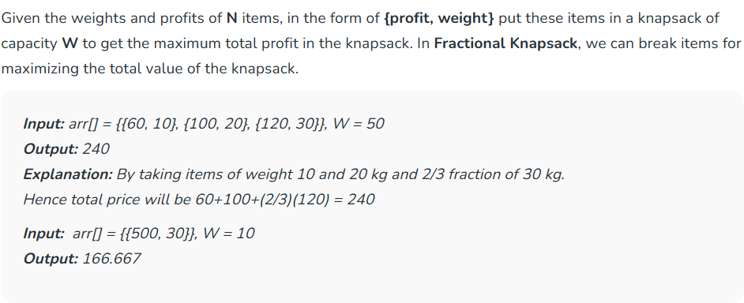
Fractional Knapsack Problem
Naive Approach: Try all possible subsets with all different fractions.
Time Complexity: O(2^{N})

Slide 96
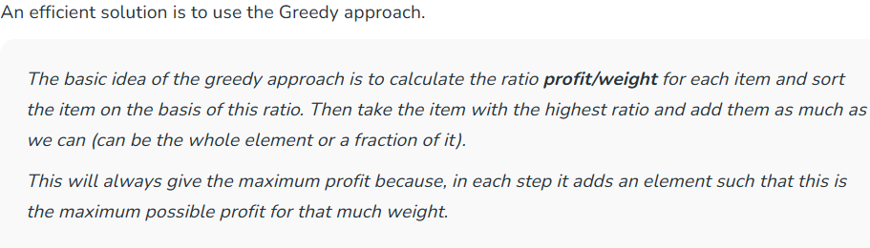
Fractional Knapsack Problem using Greedy algorithm

Slide 97
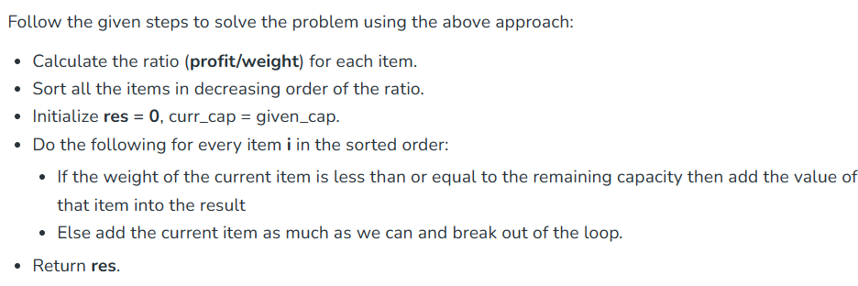
Fractional Knapsack Problem

Slide 98
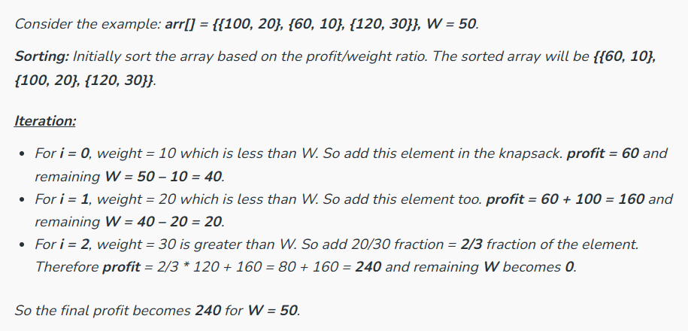
Fractional Knapsack Problem
Time Complexity: O(N * logN)

Slide 99
Huffman Code Problem
Huffman’s algorithm achieves data compression by finding the best variable length binary encoding scheme for the symbols that occur in the file to be compressed.

Slide 100
Huffman Code Problem
The more frequent a symbol occurs, the shorter should be the Huffman binary word representing it.
The Huffman code is a prefix-free code.
No prefix of a code word is equal to another codeword.

Slide 101
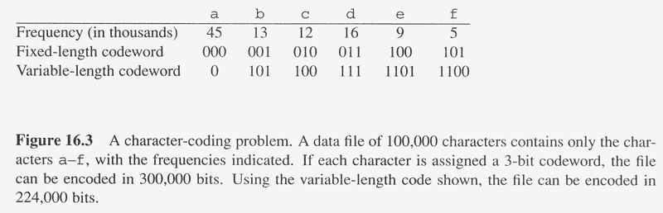
Overview
Huffman codes: compressing data (savings of 20% to 90%)
Huffman’s greedy algorithm uses a table of the frequencies of occurrence of each character to build up an optimal way of representing each character as a binary string
C: Alphabet

Slide 102
Example
Assume we are given a data file that contains only 6 symbols, namely a, b, c, d, e, f With the following frequency table:
Find a variable length prefix-free encoding scheme that compresses this data file as much as possible?

Slide 103
Huffman Code Problem
Left tree represents a fixed length encoding scheme
Right tree represents a Huffman encoding scheme

Slide 104
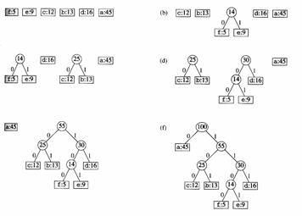
Example

Slide 105
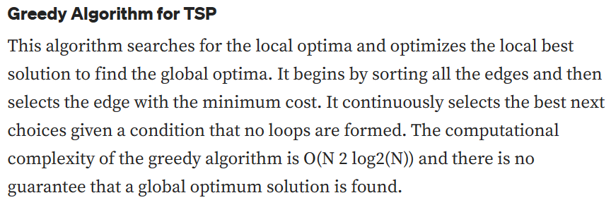

Slide 106
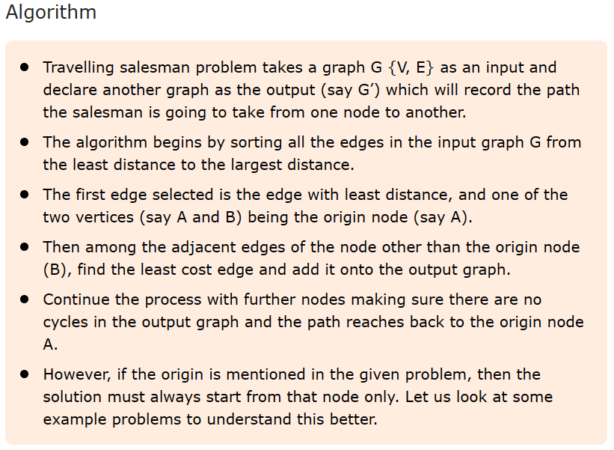
Travelling Salesman using Greedy Approach

Slide 107
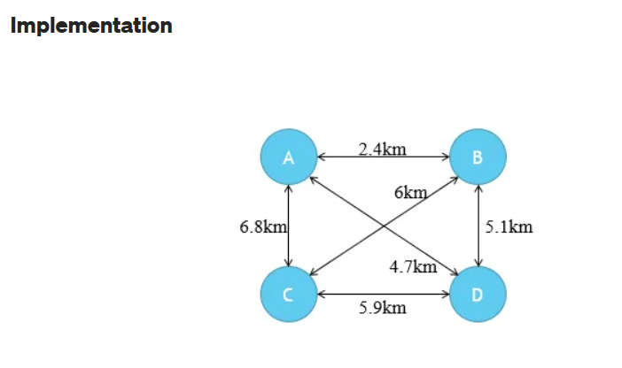

Slide 108
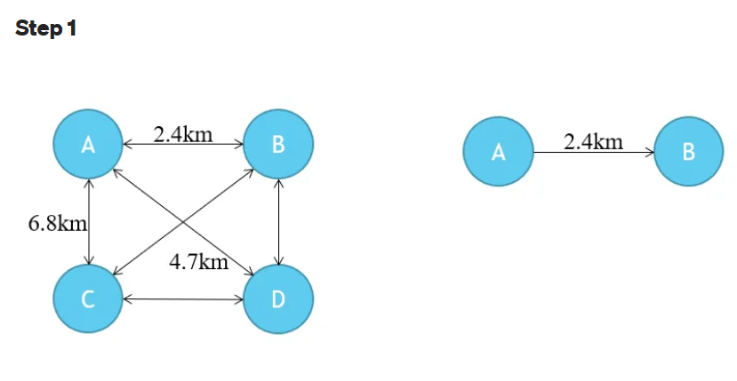

Slide 109
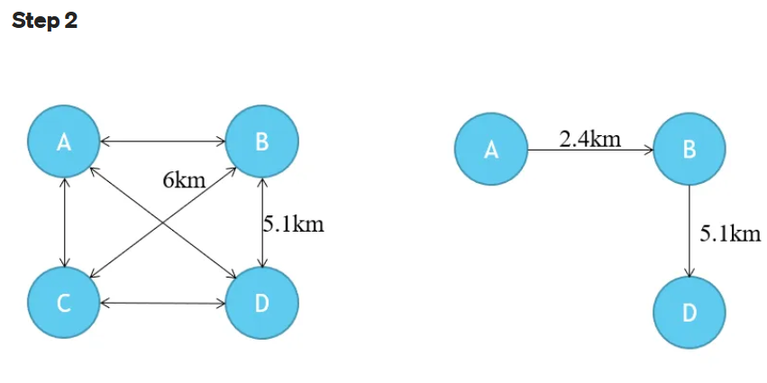

Slide 110
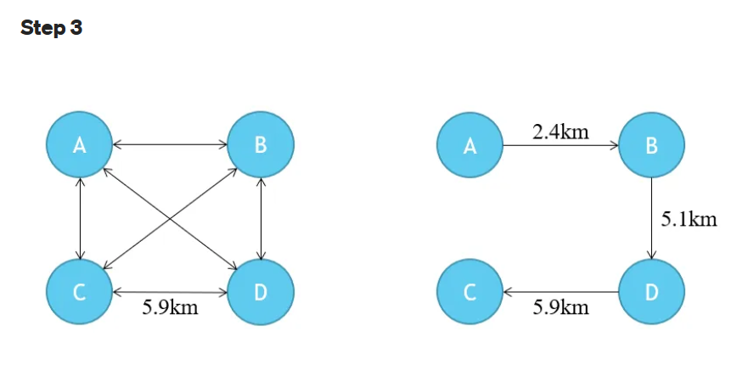

Slide 111
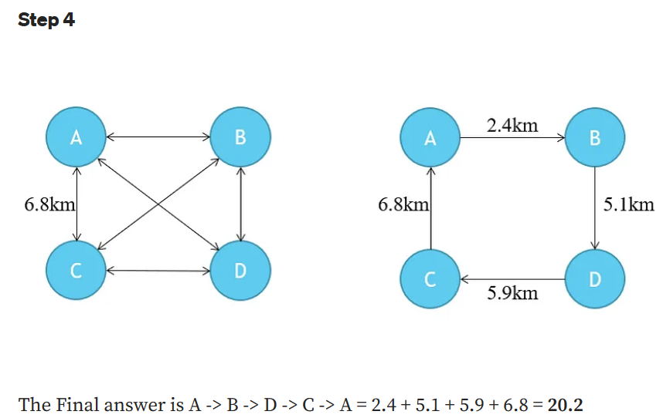

Slide 112
All pair shortest path using Dynamic Programming
The Floyd Warshall Algorithm is an all pair shortest path algorithm unlike Dijkstra and Bellman Ford which are single source shortest path algorithms. This algorithm works for both the directed and undirected weighted graphs. But, it does not work for the graphs with negative cycles (where the sum of the edges in a cycle is negative). It follows Dynamic Programming approach to check every possible path going via every possible node in order to calculate shortest distance between every pair of nodes.

Slide 113
Idea Behind Floyd Warshall Algortihm:
Suppose we have a graph G[][] with V vertices from 1 to N. Now we have to evaluate a shortestPathMatrix[][] where shortestPathMatrix[i][j] represents the shortest path between vertices i and j.
Obviously the shortest path between i to j will have some k number of intermediate nodes. The idea behind floyd warshall algorithm is to treat each and every vertex from 1 to N as an intermediate node one by one.

Slide 114
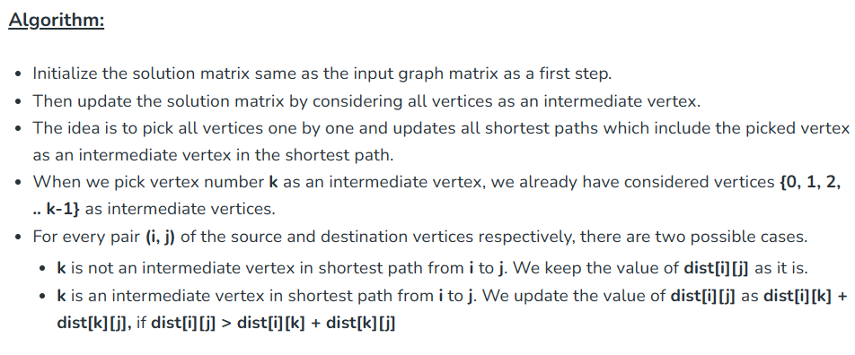
All pair shortest path using Dynamic Programming

Slide 115
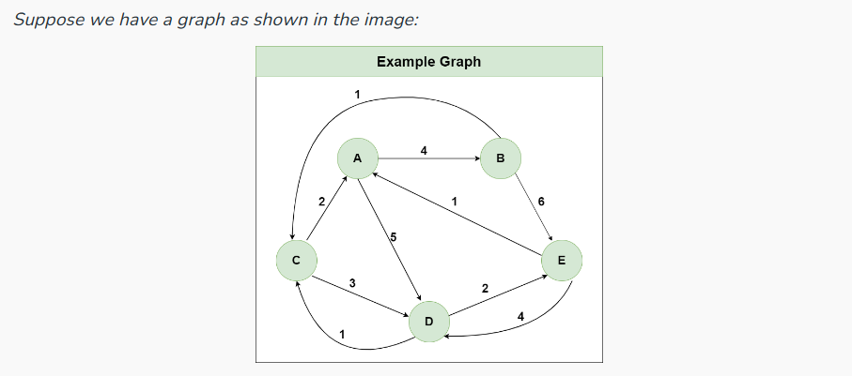
All pair shortest path using Dynamic Programming

Slide 116
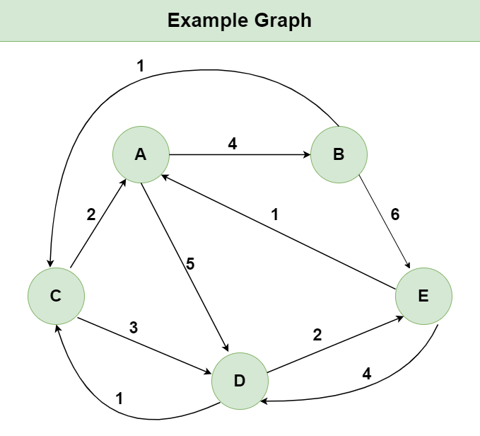

Slide 117
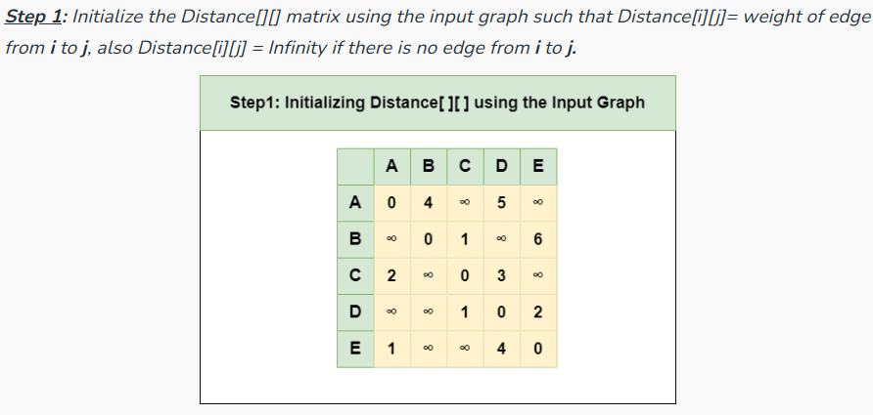
All pair shortest path using Dynamic Programming

Slide 118
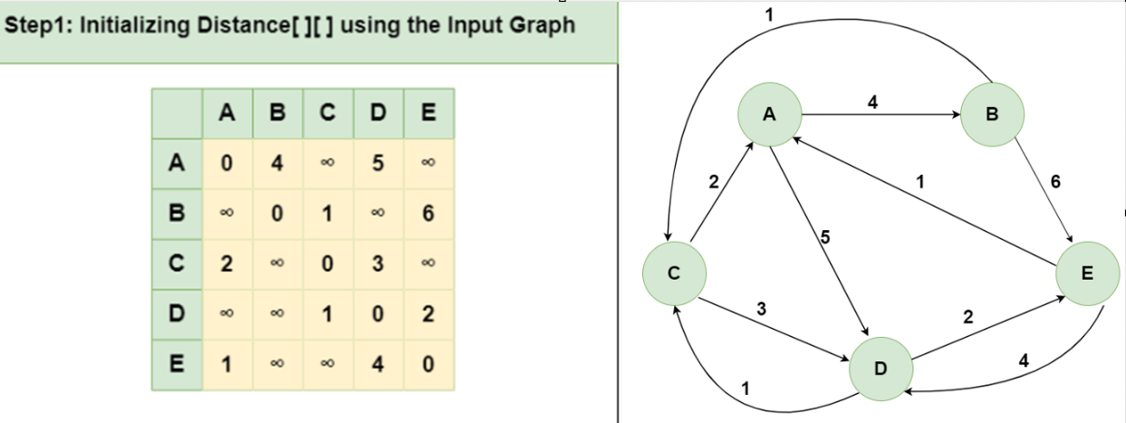

Slide 119
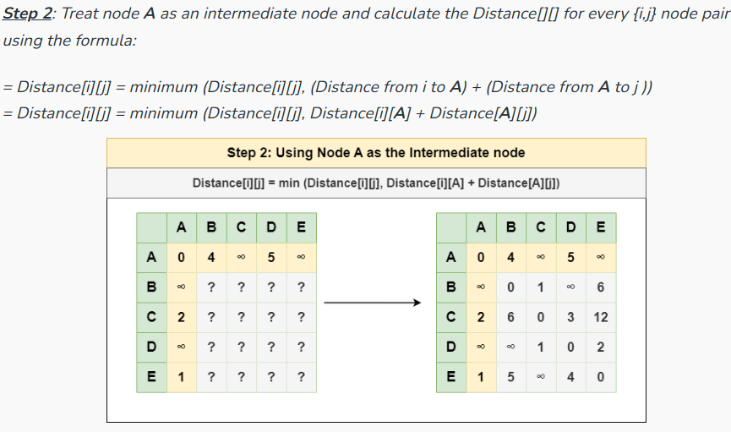
All pair shortest path using Dynamic Programming

Slide 120
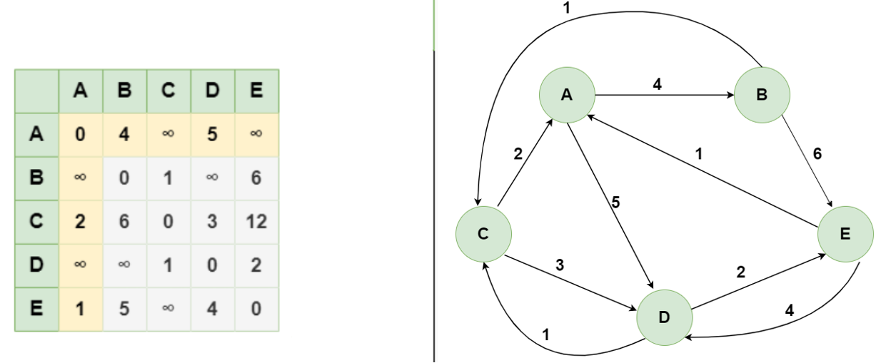

Slide 121
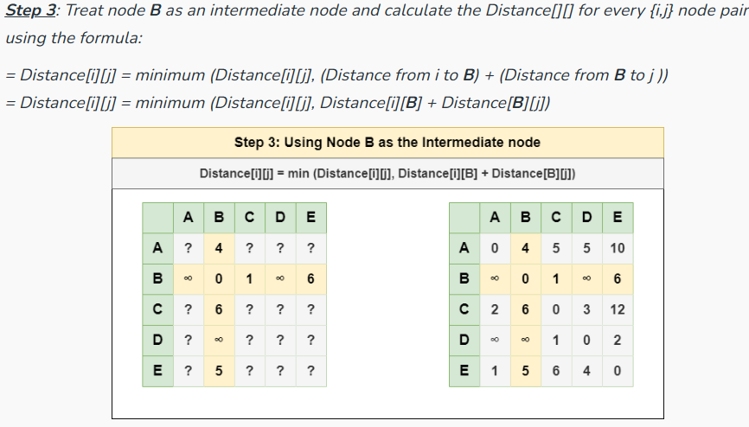
All pair shortest path using Dynamic Programming

Slide 122
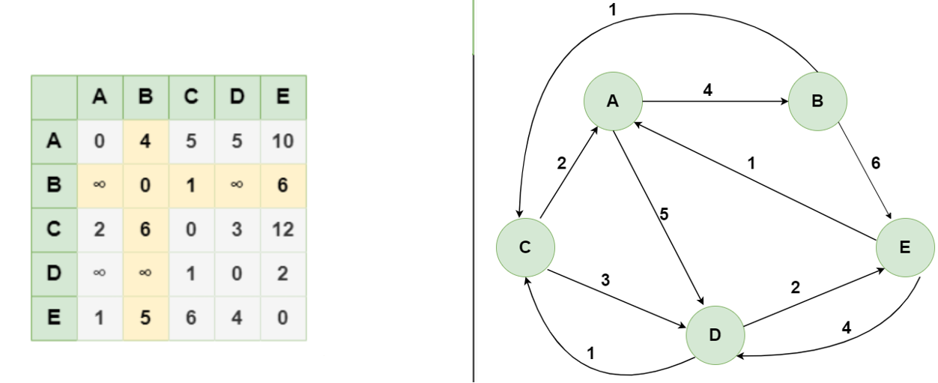

Slide 123
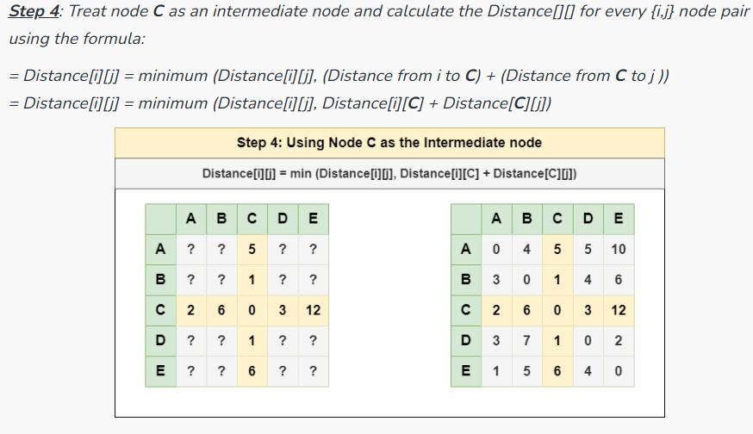
All pair shortest path using Dynamic Programming

Slide 124
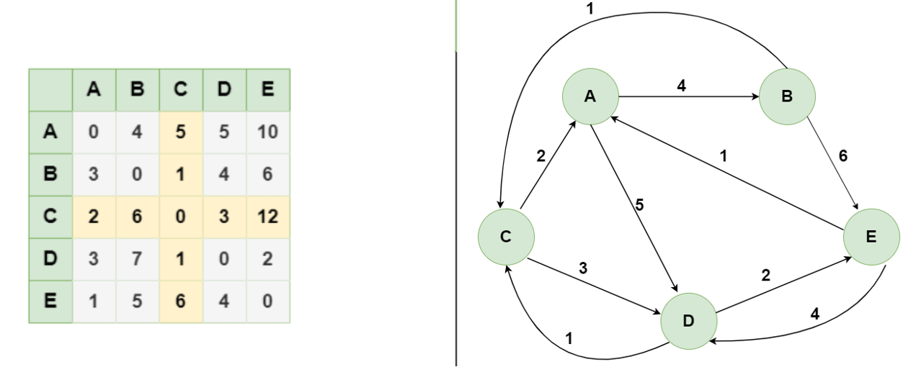

Slide 125
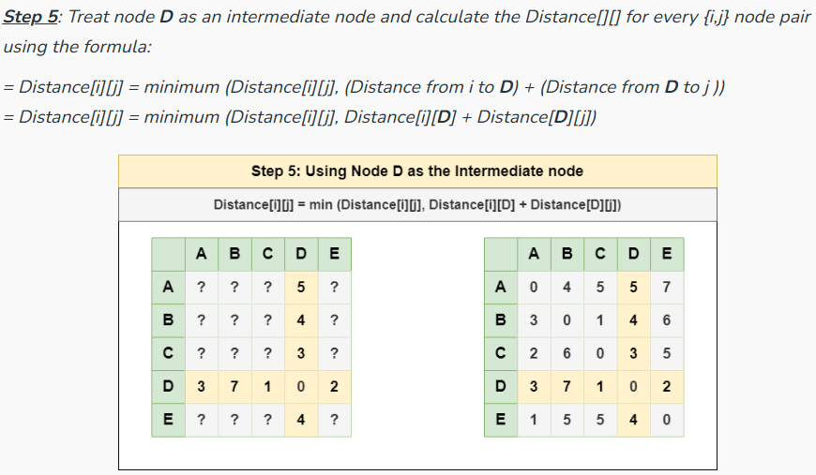
All pair shortest path using Dynamic Programming

Slide 126
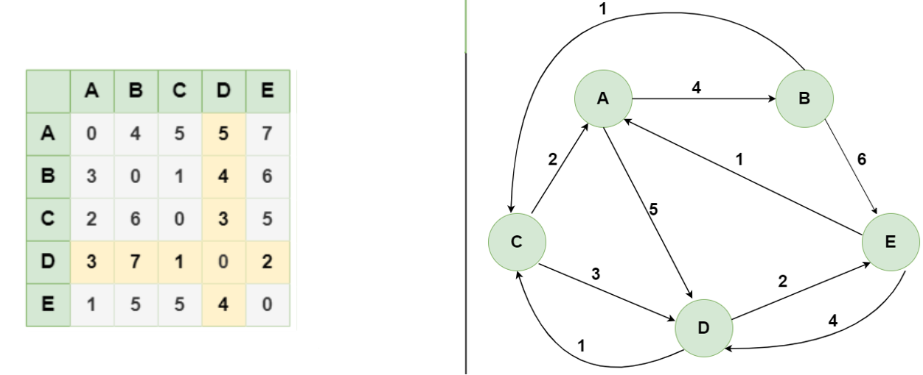

Slide 127
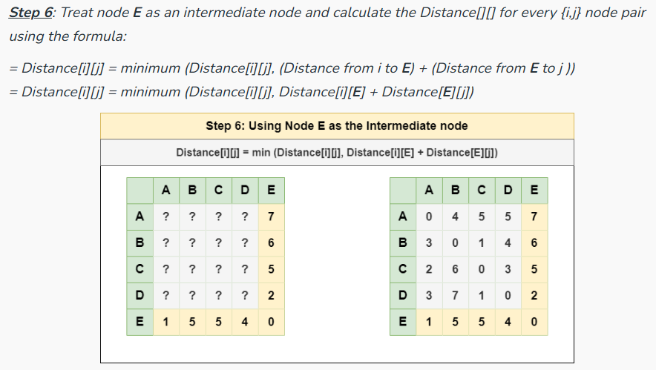
All pair shortest path using Dynamic Programming

Slide 128
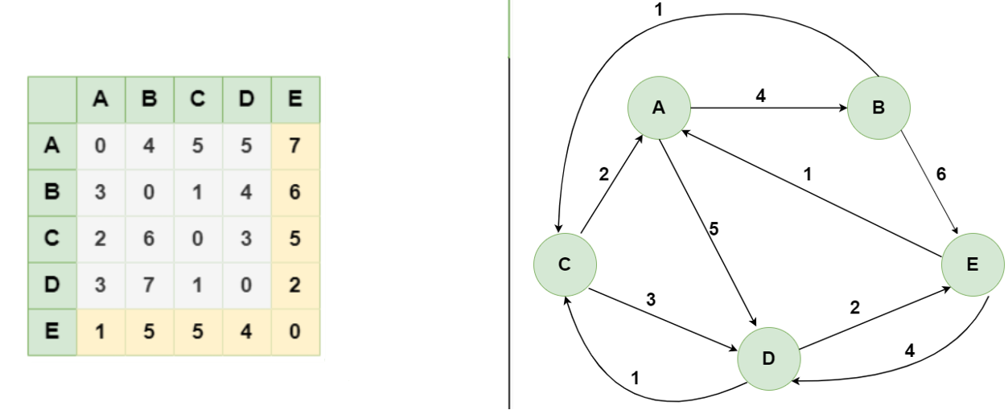

Slide 129
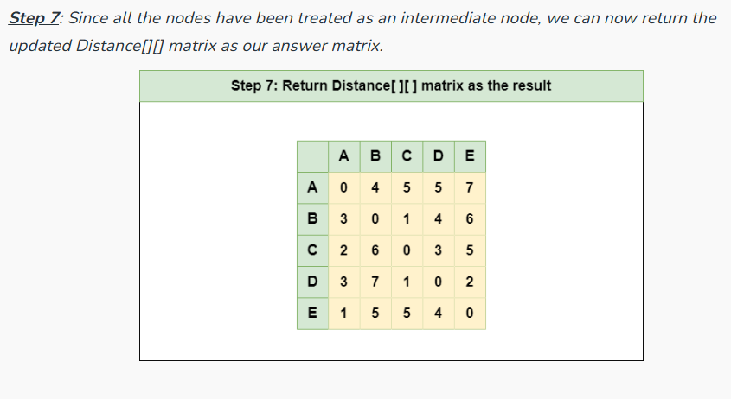
All pair shortest path using Dynamic Programming

Slide 130
Thank you

Slide 131
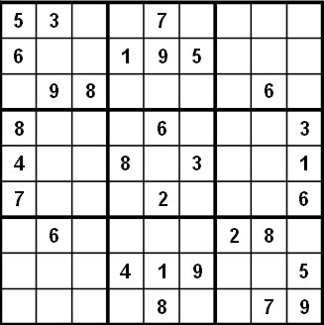
Problem1:SUDOKU
Sudoku
9 by 9 matrix with some numbers filled in
all numbers must be between 1 and 9
Goal: Each row, each column, and each mini matrix must contain the numbers between 1 and 9 once each
no duplicates in rows, columns, or mini matrices

Slide 132

Solving Sudoku – Brute Force
A brute force algorithm is a simple but general approach
Try all combinations until you find one that works
This approach isn’t clever, but computers are fast
Then try and improve on the brute force results

Slide 133
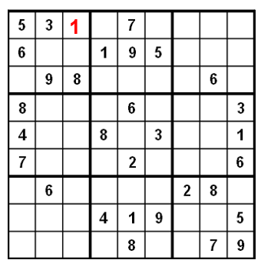
Solving Sudoku:
Brute force Sudoku Solution
if not open cells, solved
scan cells from left to right, top to bottom for first open cell
When an open cell is found start cycling through digits 1 to 9.
When a digit is placed check that the set up is legal
now solve the board

Slide 134
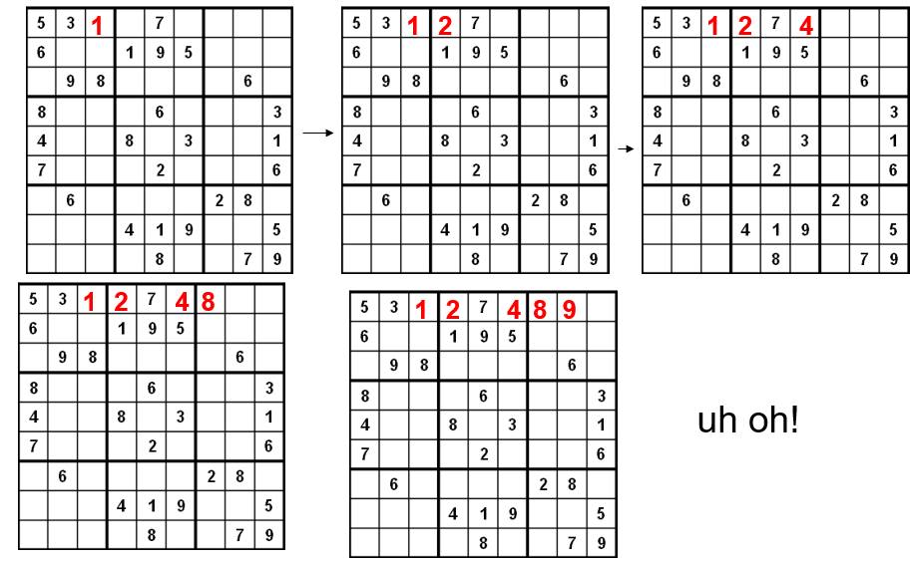

Slide 135
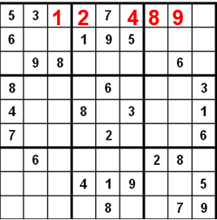
Sudoku – A Dead End
We have reached a dead end in our search
With the current set up none of the nine digits work in the top right corner

Slide 136
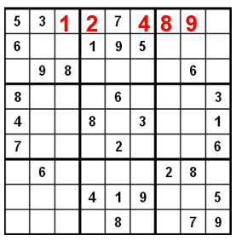
Backing Up:
When the search reaches a dead end in backs up to the previous cell it was trying to fill and goes onto to the next digit
We would back up to the cell with a 9 and that turns out to be a dead end as well so we back up again
so the algorithm needs to remember what digit to try next
Now in the cell with the 8. We try and 9 and move forward again.

Slide 137
Integer multiplication
The problem:
Multiply two large integers (n digits)
The traditional way:
Use two for loops, it takes operations

Slide 138
The Divide-and-Conquer way:
Suppose large integers, , divide into two part a and b, same as into c and d.
x:
y:
a | b
c | d
So, transform the problem of multiply two integers of n-digit
into four subproblems of multiply two integers of -digit

Slide 139


Slide 140
Example of Large-Integer Multiplication
2135 ∗ 4014
= (21*10^2 + 35) * (40*10^2 + 14)
= (21*40)*10^4 + c1*10^2 + 35*14
where c1 = (21+35)*(40+14) – 21*40 – 35*14, and
21*40 = (2*10 + 1) * (4*10 + 0)
= (2*4)*10^2 + c2*10 + 1*0
where c2 = (2+1)*(4+0) - 2*4 - 1*0, etc.
This process requires 9 digit multiplications as opposed to 16.

Slide 141
Travelling Salesman Problem
A salesman must visit every city (starting from city A), and wants to cover the least possible distance
He can revisit a city (and reuse a road) if necessary
He does this by using a greedy algorithm: He goes to the next nearest city from wherever he is
From A he goes to B
From B he goes to D
This is not going to result in a shortest path!
The best result he can get now will be ABDBCE,
at a cost of 16
An actual least-cost path from A is ADBCE, at a cost of 14
A
B
C
2
4
3
3
4
4
D
E

Slide 142
Coin set Problem
For the following examples, we will assume coins in the following denominations: 1¢ 5¢ 10¢ 21¢ 25¢
We’ll use 63¢ as our goal

Slide 143
A solution
We can reduce the problem recursively by choosing the first coin, and solving for the amount that is left
For 63¢:
One 1¢ coin plus the best solution for 62¢
One 5¢ coin plus the best solution for 58¢
One 10¢ coin plus the best solution for 53¢
One 21¢ coin plus the best solution for 42¢
One 25¢ coin plus the best solution for 38¢
Choose the best solution from among the 5 given above
We solve 5 recursive problems.
This is a very expensive algorithm

Slide 144
A dynamic programming Problem
Idea: Solve first for one cent, then two cents, then three cents, etc., up to the desired amount
Save each answer in an array !
For each new amount N, combine a selected pairs of previous answers which sum to N
For example, to find the solution for 13¢,
First, solve for all of 1¢, 2¢, 3¢, ..., 12¢
Next, choose the best solution among:
Solution for 1¢ + solution for 12¢
Solution for 5¢ + solution for 8¢
Solution for 10¢ + solution for 3¢

